Slide 1
Information Retrieval and Web Search
Vasile Rus, PhD
vrus@memphis.edu
www.cs.memphis.edu/~vrus/teaching/ir-websearch/

Slide 2
Outline
Administrivia
Why Information Retrieval?
  Information Overload

Slide 3
General Information
Web Site:
  http://www.cs.memphis.edu/~vrus/teaching/ir-websearch/
Instructor
  Vasile Rus, PhD
  Office: 323 Dunn Hall
  Office Hours: 323 Dunn Hall; T-Th 1:00-2:00PM
  Phone: x5259
  E-mail: vrus@memphis.edu
TA
  TBD
  Office hours: TBD

Slide 4
Why Attending this Class ?
will help you cope with the information overload problem
will allow you to design and implement solutions for handling large collections of information
is FUN! (hopefully)

Slide 5
Syllabus
Week 1: Introduction to IR and Web Search
Week 2: Introduction to PERL
Week 3: Classic IR: Boolean and Vectorial Models
Week 4: More IR Models
Week 5: Evaluation in IR
Week 6: Query Operations and Languages
Week 7: Text Properties, Text Operations
Week 8: NO CLASS – FALL BREAK, Indexing and Searching, Review
Week 9: MIDTERM, WWW and Web Search Intro

Slide 6
Syllabus (cont’d)
Week 10: Web Search
Week 11: Text Categorization
Week 12: Text Clustering
Week 13: Question Answering
Week 14: Advanced IR Models, THANKSGIVING HOLIDAY
Week 15: Project Presentations, Review
Week 16: Final Exam

Slide 7
To be successful you need to
Read the syllabus
Understand the structure of the course
Read the general policies
Attend classes and participate by asking questions or/and contributing with related remarks
Explore the course website

Slide 8
To be successful you need to
Try to enjoy the programming assignments
Don't limit yourself to what is asked in class

Slide 9
Grading
Assignments
  6-8 (or more)
  Assignments: 45%
2 Exams
  Midterm (20%)
  Quiz #1, #2, #3 (10% each)
Active Participation, Presentations (5%)

Slide 10
Grading
Grade | Letter Grade
90-100+ | A
80-89 | B
70-79 | C
60-69 | D
0-59 | F
2.5 above or below the cut-off will earn you a + or – in front of your grade.
For example: 89 has a letter equivalent of B+
Exception: 90-91 will give you A-, 92 to 96 will give you A, anything above 97 means A+.

Slide 11
Other Issues
Attendance can help you when on borderline
PhD Students need to make a class presentation (besides project presentation)
General announcements are posted on the web site frequently!
  Please check it out as often as possible
If you notice any inconsistencies on the website (broken links, misspellings, etc.) please notify me
  Thank you!

Slide 12
Bibliography
REQUIRED:
  Baeza-Yates & Ribeiro-Neto Modern Information Retrieval (required)
RECOMMENDED (!)
  Frakes & Baeza-Yates Information Retrieval: Data Structures and Algorithms
  C. Manning, P. Raghavan, and H. Schutze: Introduction to Information Retrieval

Slide 13
Office Hours and Extra Help
During the following times I'll be available in my office
  TTh: 1:00PM - 2:00PM
By appointment
  You must send me an email to set up an appointment
  If you just knock on my door without notice the chances are that I'll be busy
TA’s office hours can be found on the website
Please use the office hours!

Slide 14
Assignment Submission
Submissions:
  You will have on average one-two weeks from the date the work is assigned
  Late submissions are not accepted
  In exceptional cases you may have a 48-hour grace period at the cost of 50% of the grade (you should ask for it before the due date)

Slide 15
Programming Assignments
Programming submissions
  are Electronic (using a form or email) AND on paper
  should contain your name as part of the file name and the assignment number
    e.g.: vasileRus.Assignment01.sh
  (the code) should be well indented and contain lots of comments
    see the Recommended code-style guidelines on the website
  Each file should contain a header as given in the next slide
  If multiple files are submitted, pack them using gzip, tar, etc.

Slide 16
File Header
/*************************************
* Name: FileName, Package name if necessary
* Assignment: assignment ID
* Description: a text describing the assignment
* Author: Your Name
* Date: put here the due date
* Comments: any comments you think are necessary
*************************************/

Slide 17
Plagiarism
Plagiarism
  Plagiarism is not tolerated. If caught, you'll be given grade 0 (zero) and disciplinary actions will be taken
It's OK to help some of your friends who may have problems
  This is actually a good learning tool
but it is not OK to share code or answers. If they need, help/discuss with them but never show them your code
I may (and I will) ask you to demonstrate and explain your programs

Slide 18
Exams
During exams you should sit as far from each other as possible
As rule of thumb, leave at least one chair between you and any other student
Usually, all exams are closed book
Exams are normally made of:
  true-false questions
  multiple-choice questions
  “open” questions (programming or not)
There are no make-up exams

Slide 19
Questions

Slide 20
Information Overload
“The greatest problem of today is how to teach people to ignore the irrelevant, how to refuse to know things, before they are suffocated. For too many facts are as bad as none at all.” (W.H. Auden)

Slide 21
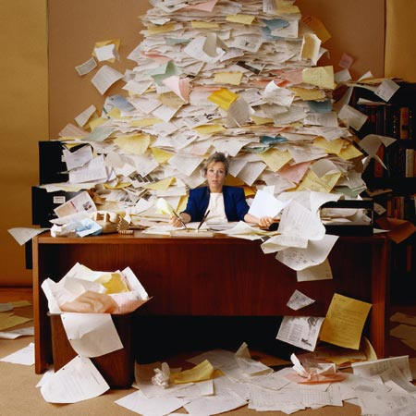
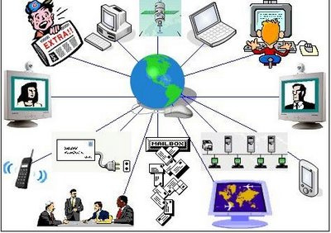
Information Overload

Slide 22
Coping With It!
“reserve large blocks of time on your calendar, don’t answer the phone, and return calls in short bursts once or twice a day” (Drucker, 1967)

Slide 23
Coping With It!
some combination of focusing, filtering, and forgetting
It requires a tremendous amount of self-discipline, and we can’t do it alone: in our teams and across the whole organization, we need to establish a set of norms that support a more productive way of working.
“Multitasking is not heroic; it’s counterproductive”
http://www.mckinsey.com/insights/organization/recovering_from_information_overload

Slide 24
Coping With It!
We have to admit, for example, that we do feel satisfied when we can respond quickly to requests and that doing so somewhat validates our desire to feel so necessary to the business that we rarely switch off. There’s nothing wrong with these feelings, but we need to consider them alongside their measurable cost to our long-term effectiveness. No one would argue that burning up all of a company’s resources is a good strategy for long-term success, and that is equally true of its leaders and their mental resources.

Slide 25
What kinds of information are there?
Text
  books, periodicals, WWW, memos, ads
  published/refeered
Film
Photos, other Images
Broadcast TV, Radio
Telephone Conversations
Databases

Slide 26
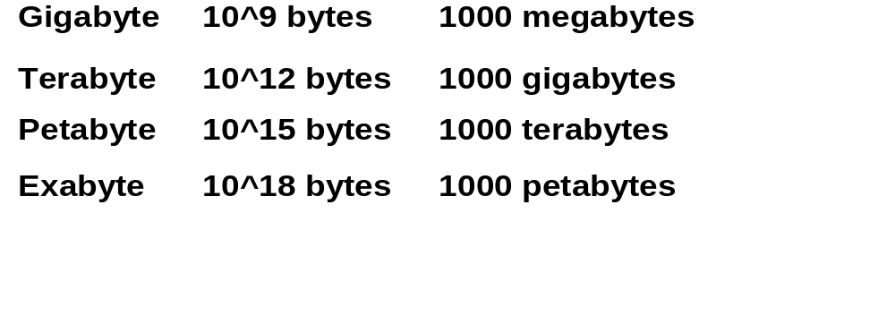
How much information is there?
(Estimates courtesy of Hal Varian and Peter Lyman)
Original: http://www.sims.berkeley.edu/emc
Newer: http://www2.sims.berkeley.edu/research/projects/how-much-info-2003/

Slide 27
How Much Information?
Stored Information
  Print
  Film
  Optical
  Magnetic
Communicated
  Internet
  Broadcast
  Phone
  Mail

Slide 28
Print
Annual Production
  Books 968,735 = 8 Terabytes (compressed image)
  Newspapers 22643 = 25 Terabytes
  Journals 40000 = 2 Terabytes
  Magazines 80000 = 10 Terabytes
  Office Documents 12x10^9 pages = 312 Terabytes
  TOTAL 357 Terabytes

Slide 29
Print
Library of Congress Printed book collection
  About 18 Million books
  About 130 Terabytes (compressed image)
  For all of LC we should also assume
    13M photographs, 5MB each = 65 TB
    4M maps, say 200 TB
    500K files, 1GB each = 500 TB
    3.5M sound recordings, ~2000 TB
    Grand total: 3 petabytes (~3000 terabytes)
Books in Print (which you can buy TODAY)
  3.2 Million titles
  About 26 Terabytes

Slide 30
Totals Stored Per Year
Medium Type of content Terabytes/Year Terabytes/Year
Upper Bound Lower Bound
Paper
Books 8 7
Newspapers 25 20
Periodicals 12 12
Office documents 312 312
SUBTOTAL 357 351
Film
Photographs 410,000 100,000
Cinema 16 16
X-Rays 12,000 12,000
SUBTOTAL 422,000 112,016
Optical
Music CDs 58 40
Data CDs 3 3
DVDs 22 22
SUBTOTAL 83 65
Magnetic
Camcorder 300,000 300,000
Disk drives 2,555,000 1,000,20
SUBTOTAL 2,855,000 1,300,200
TOTAL 3,277,440 1,412,632

Slide 31
Human Memory
Landauer 86: Human brain holds 200MB
  looked at rate of information intake and rate of forgetting, and amount of information adults need for normal tasks
6B people on earth implies total memory of all people alive about 1,200 petabytes
Another way:
  estimate that people take in a byte/sec
  lifetime 250,000 days or 2B sec
  result is 2 GB (doesn’t count synthesizing new info)

Slide 32
Summary
Administrivia
Why Information Retrieval

Slide 33
Next
Introduction to Information Retrieval

